Slide 1
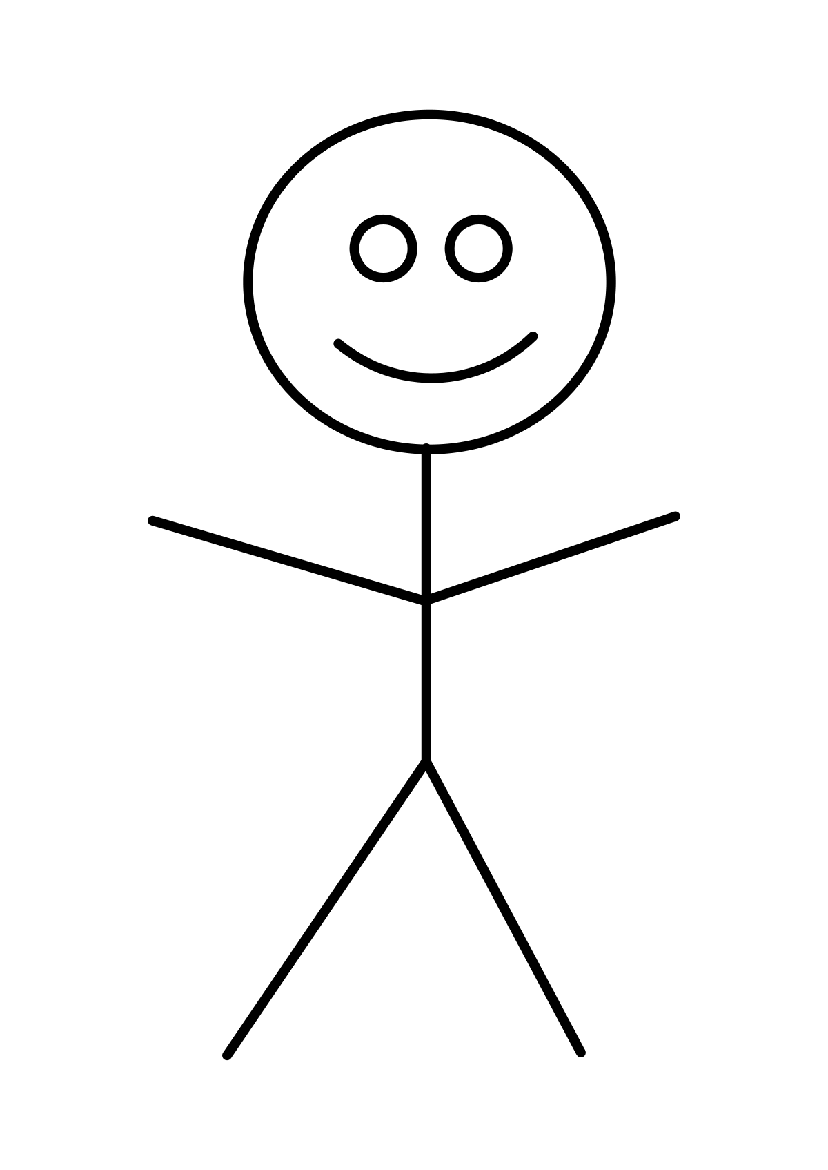
Start Menu
User
Play Game
Only able to interact with the player’s ship
Game Ends
(soon to come) Options
Change sound options
Change aesthetics options

